Slide 1

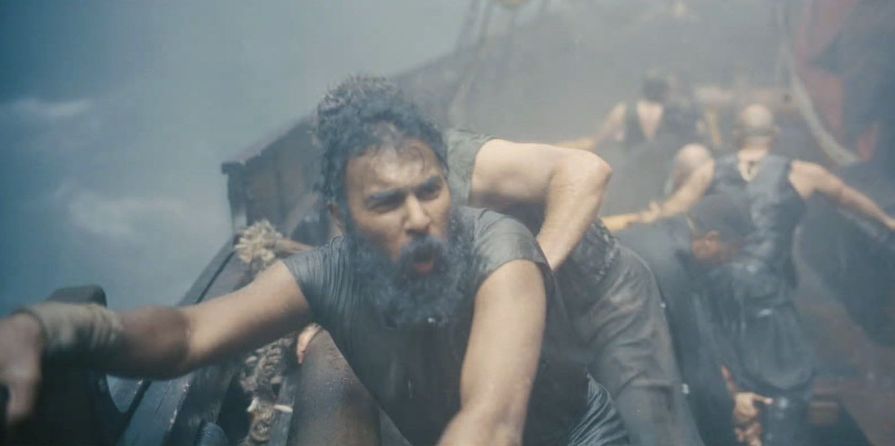
A thought experiment

Slide 2

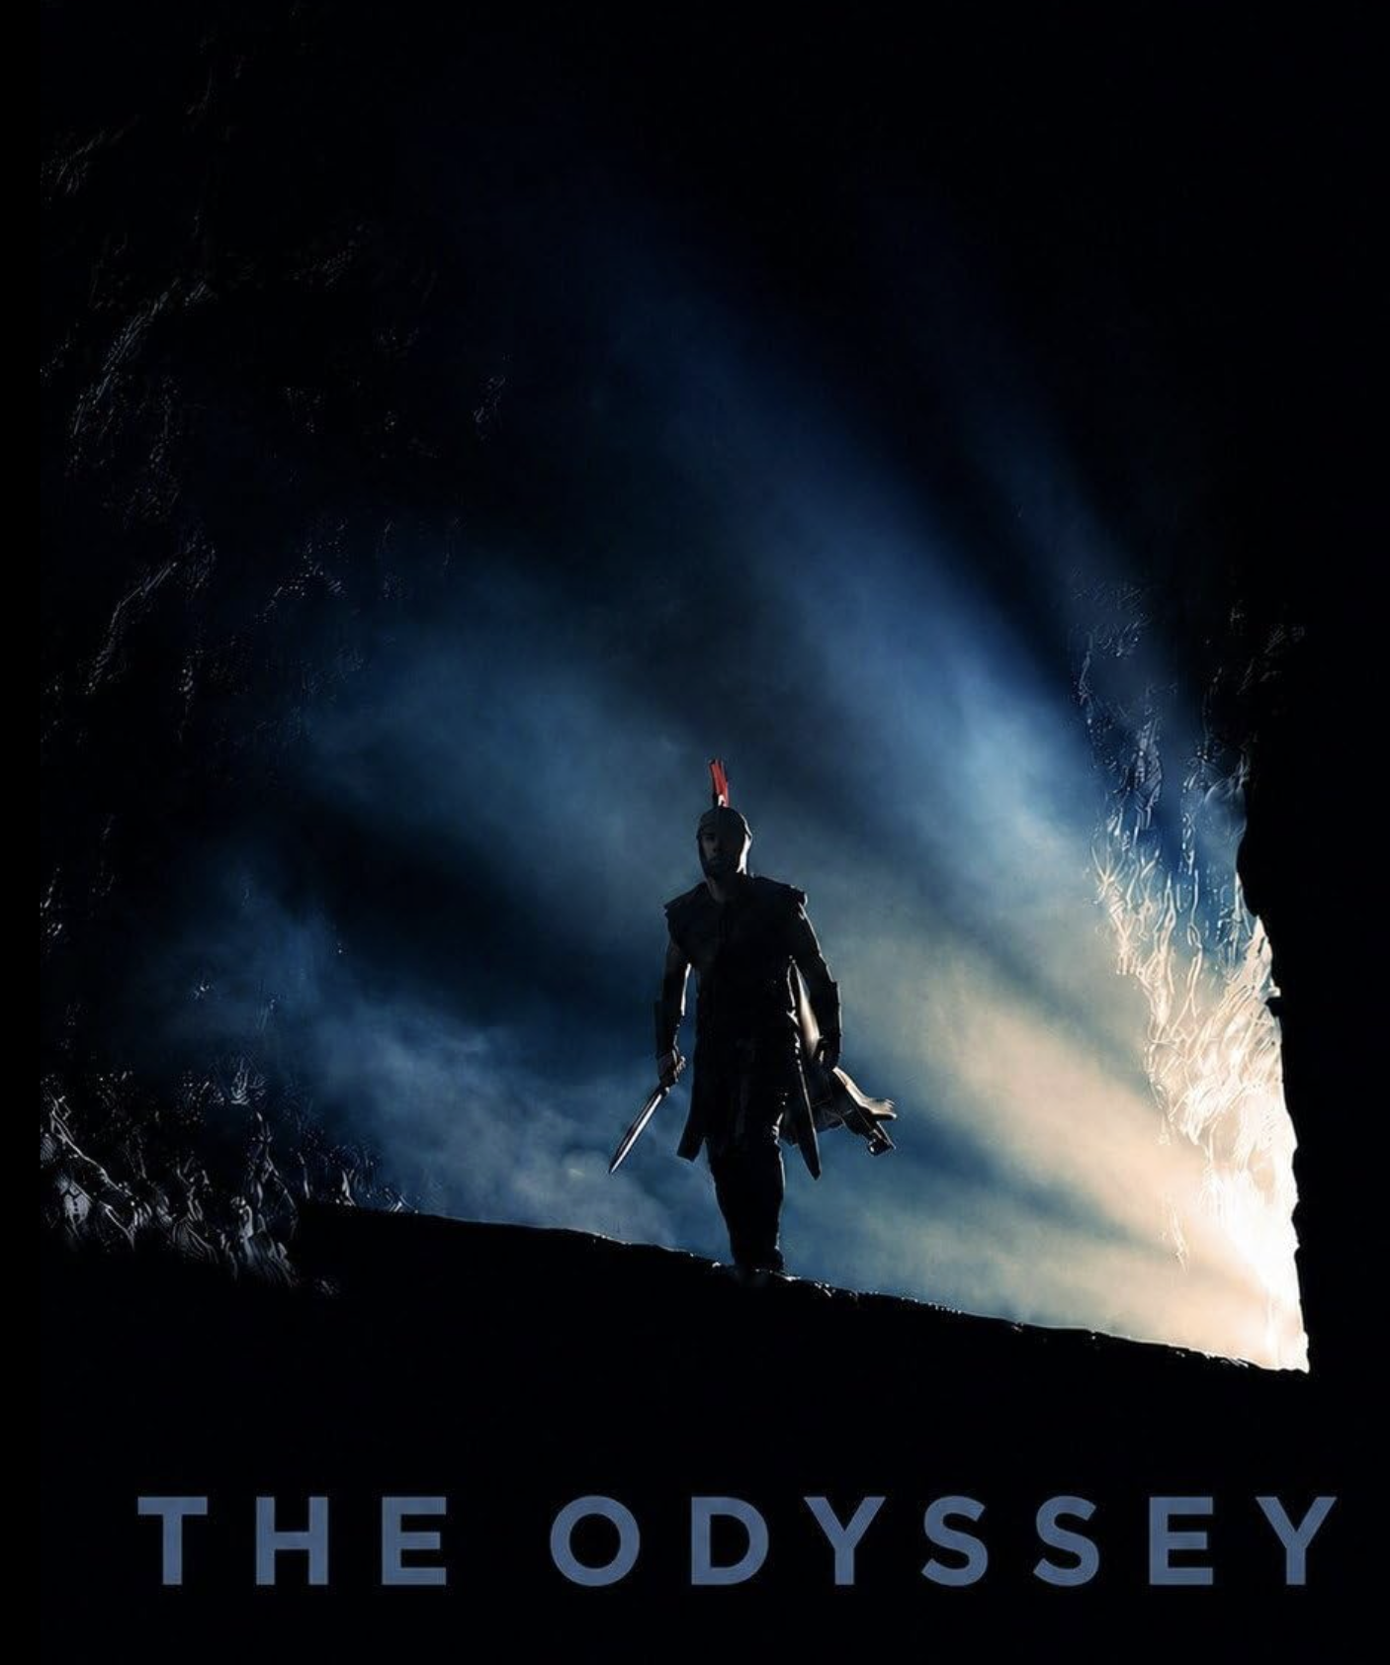
The Odyssey
Universal Pictures
15

Slide 3
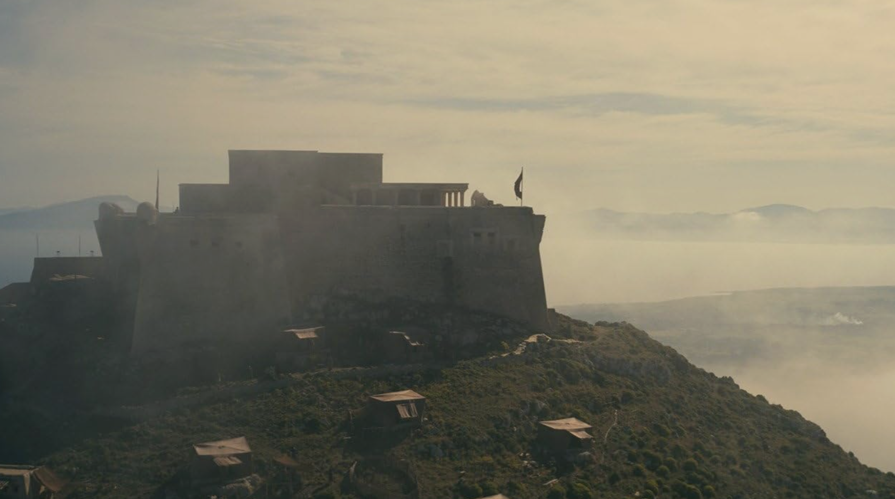
A kingdom in crisis

Slide 4
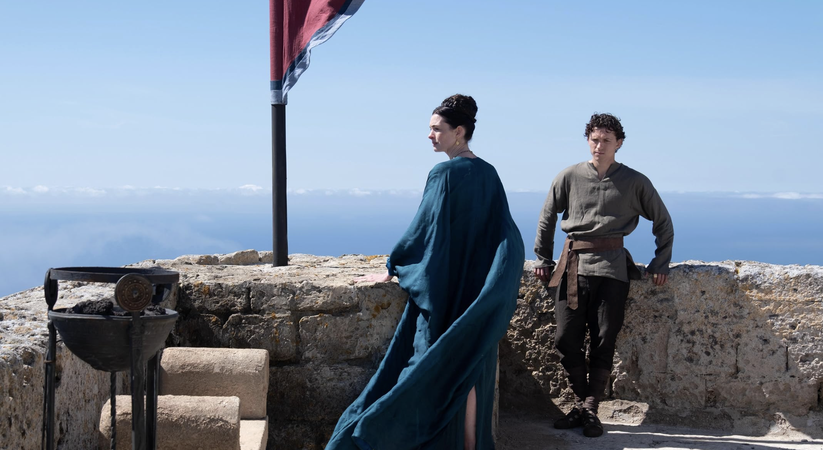
A son determined to defend his father's legacy

Slide 5
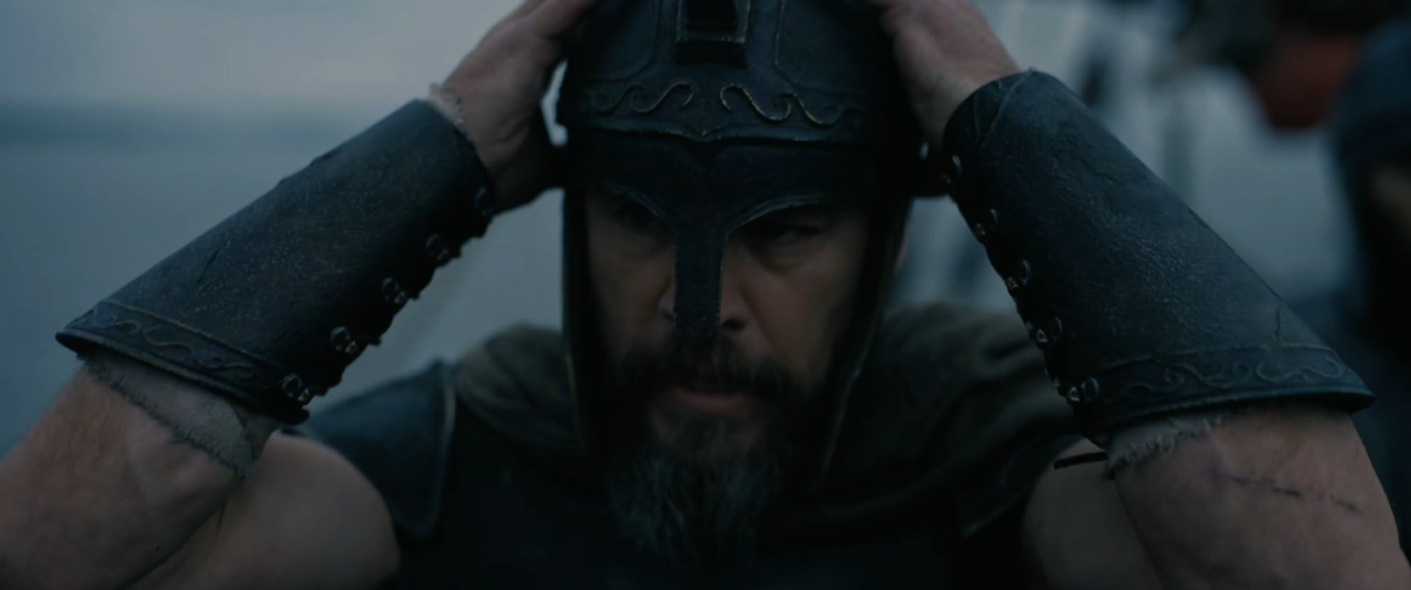
Odysseus prepares for his return

Slide 6
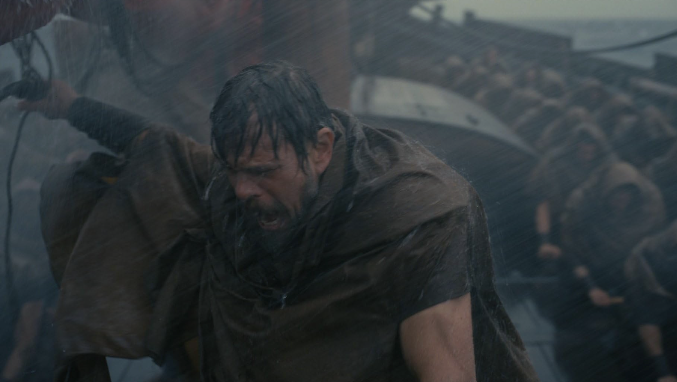
A dangerous journey home

Slide 7
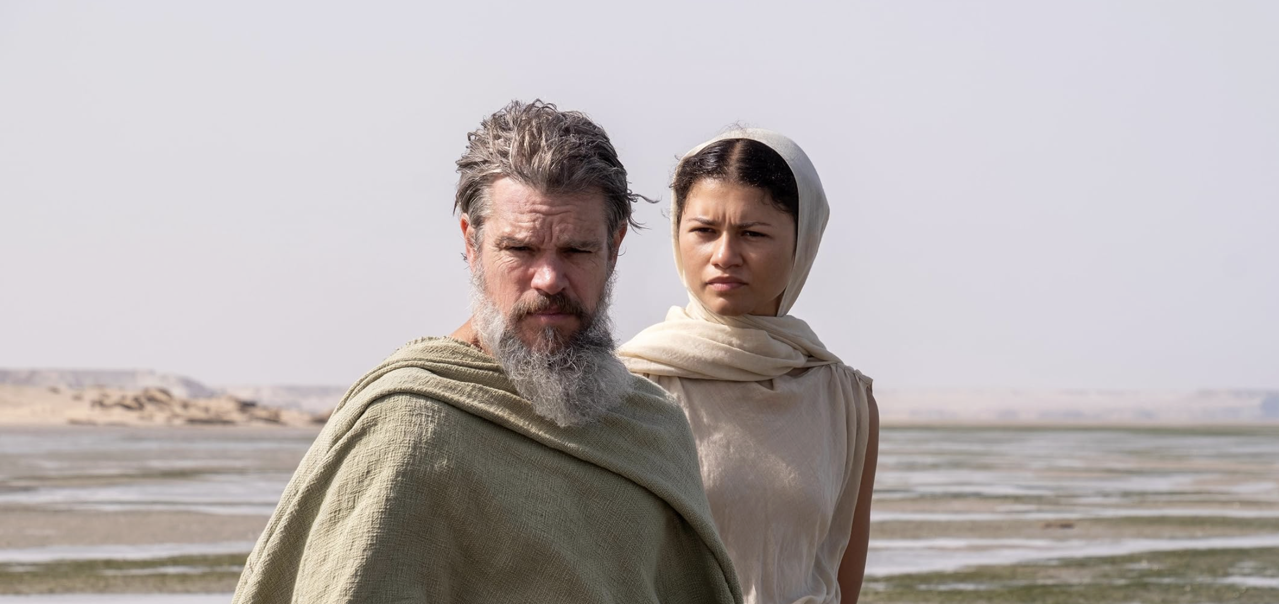
“You gods don't speak in ways we understand”
“Who doesn't understand pain or blood?”

Slide 8
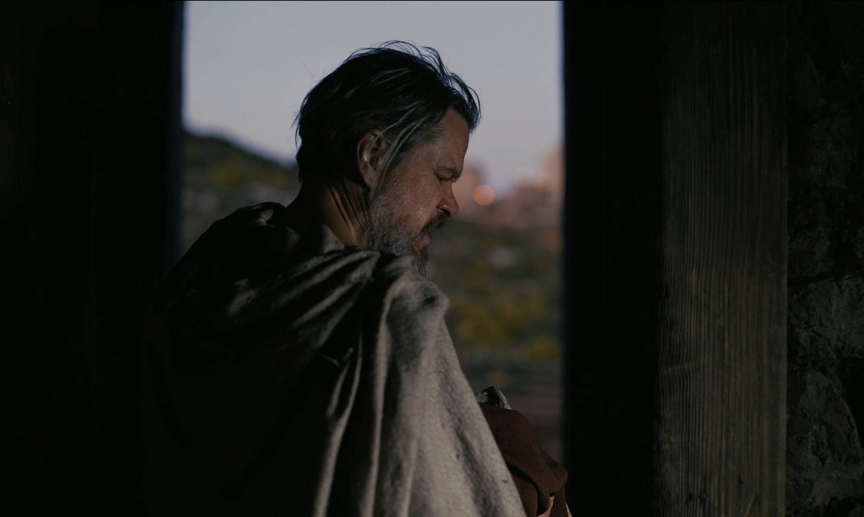
“Then I defy the gods”

Slide 9
“You gods don't speak in ways we understand”
“Who doesn't understand pain or blood?”

Slide 10

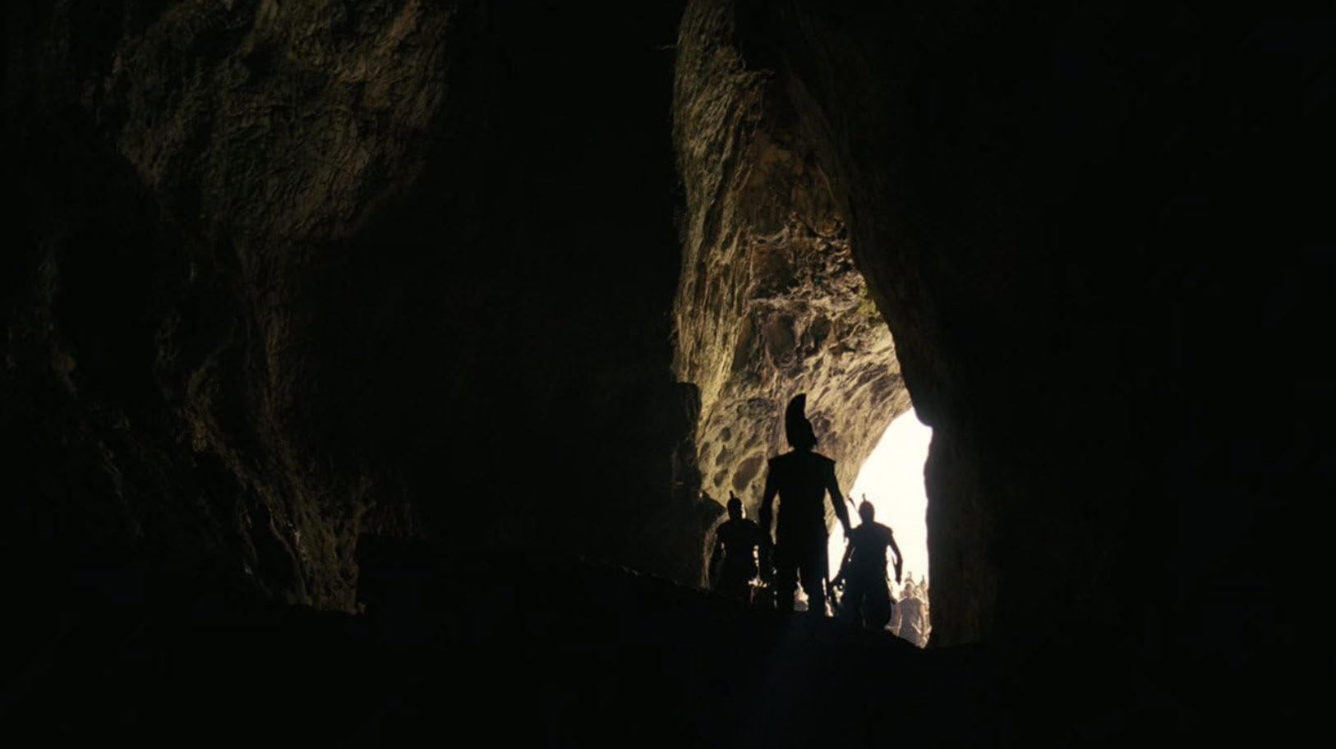
Trapped by Polyphemus, punished by Poseidon

Slide 11
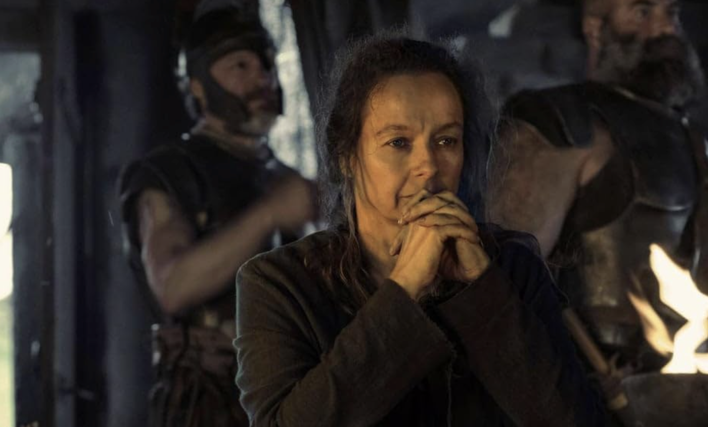
Circe turns Odysseus' men into
pigs

Slide 12
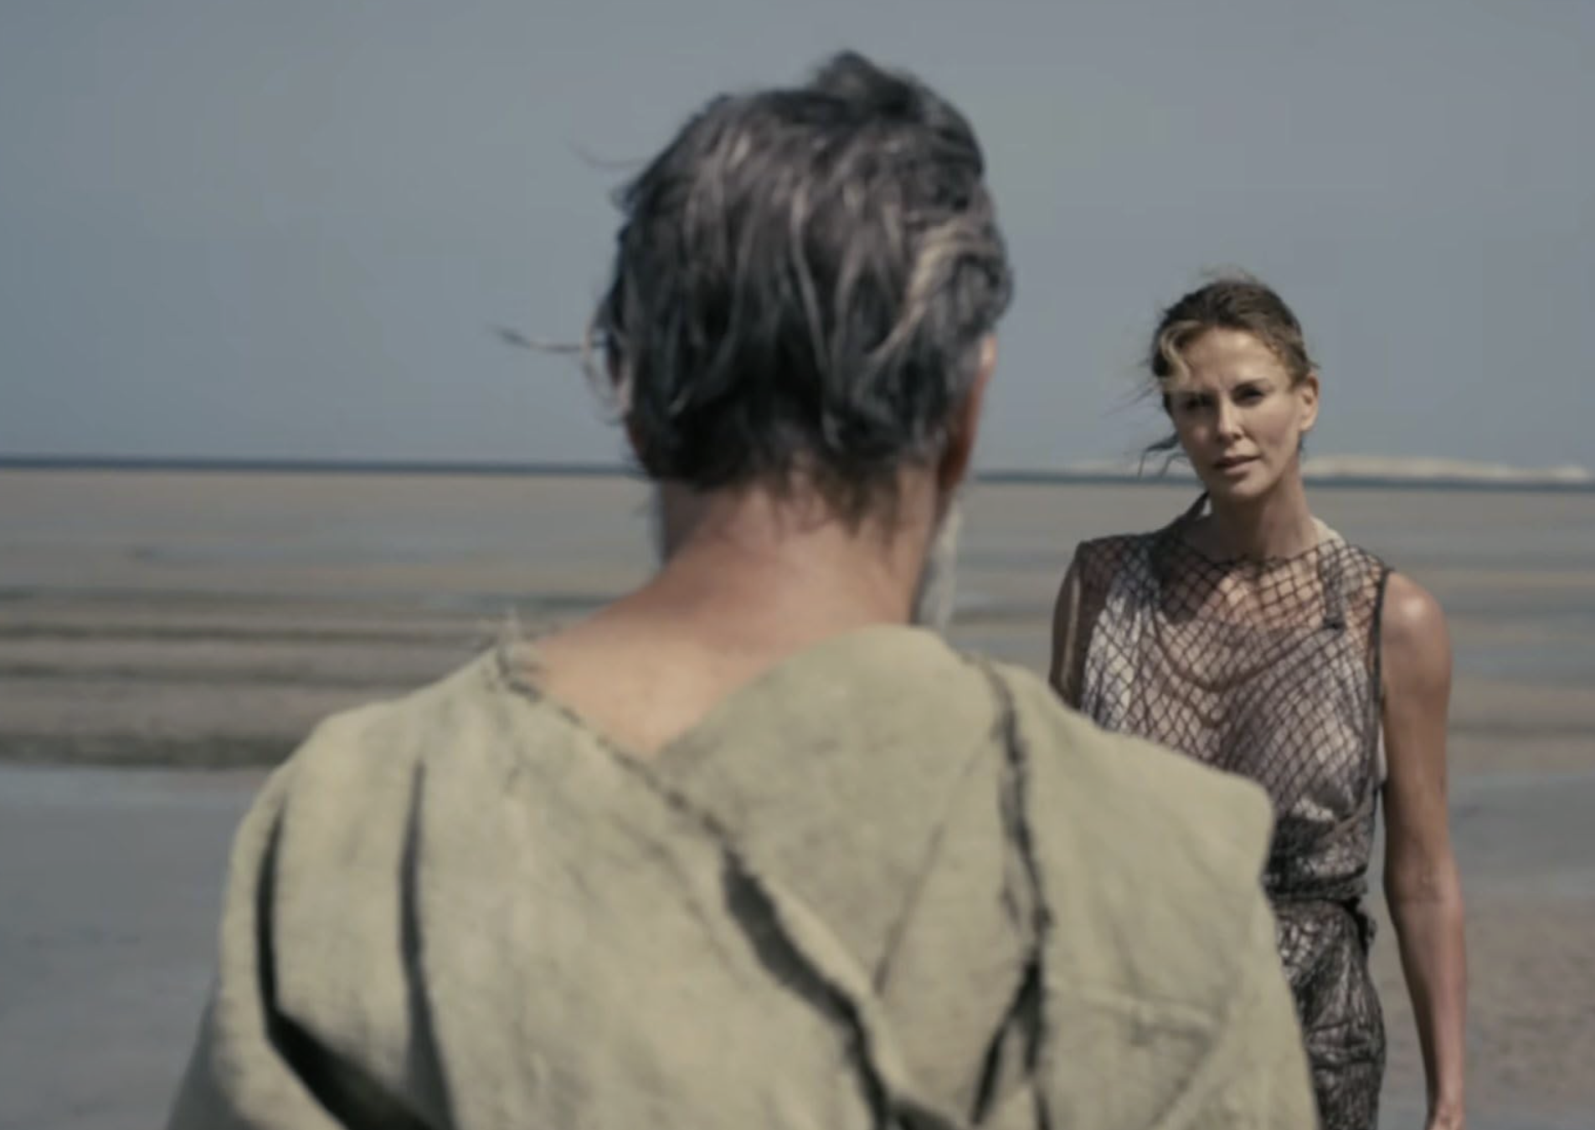
Found,
and held,
by Calypso

Slide 13
“Then I defy the gods”

Slide 14
“Anyone who does not love does not know God, because God is love. Here is how God showed his love among us. He sent his one and only Son into the world. He sent him so we could receive life through him. Here is what love is. It is not that we loved God. It is that he loved us and sent his Son to give his life to pay for our sins.” (1 John 4:8-10)
“Suppose your son asks for bread. Which of you will give him a stone? Or suppose he asks for a fish. Which of you will give him a snake? Even though you are evil, you know how to give good gifts to your children. How much more will your Father who is in heaven give good gifts to those who ask him.” (Matthew 7:9-11)

