Slide 1

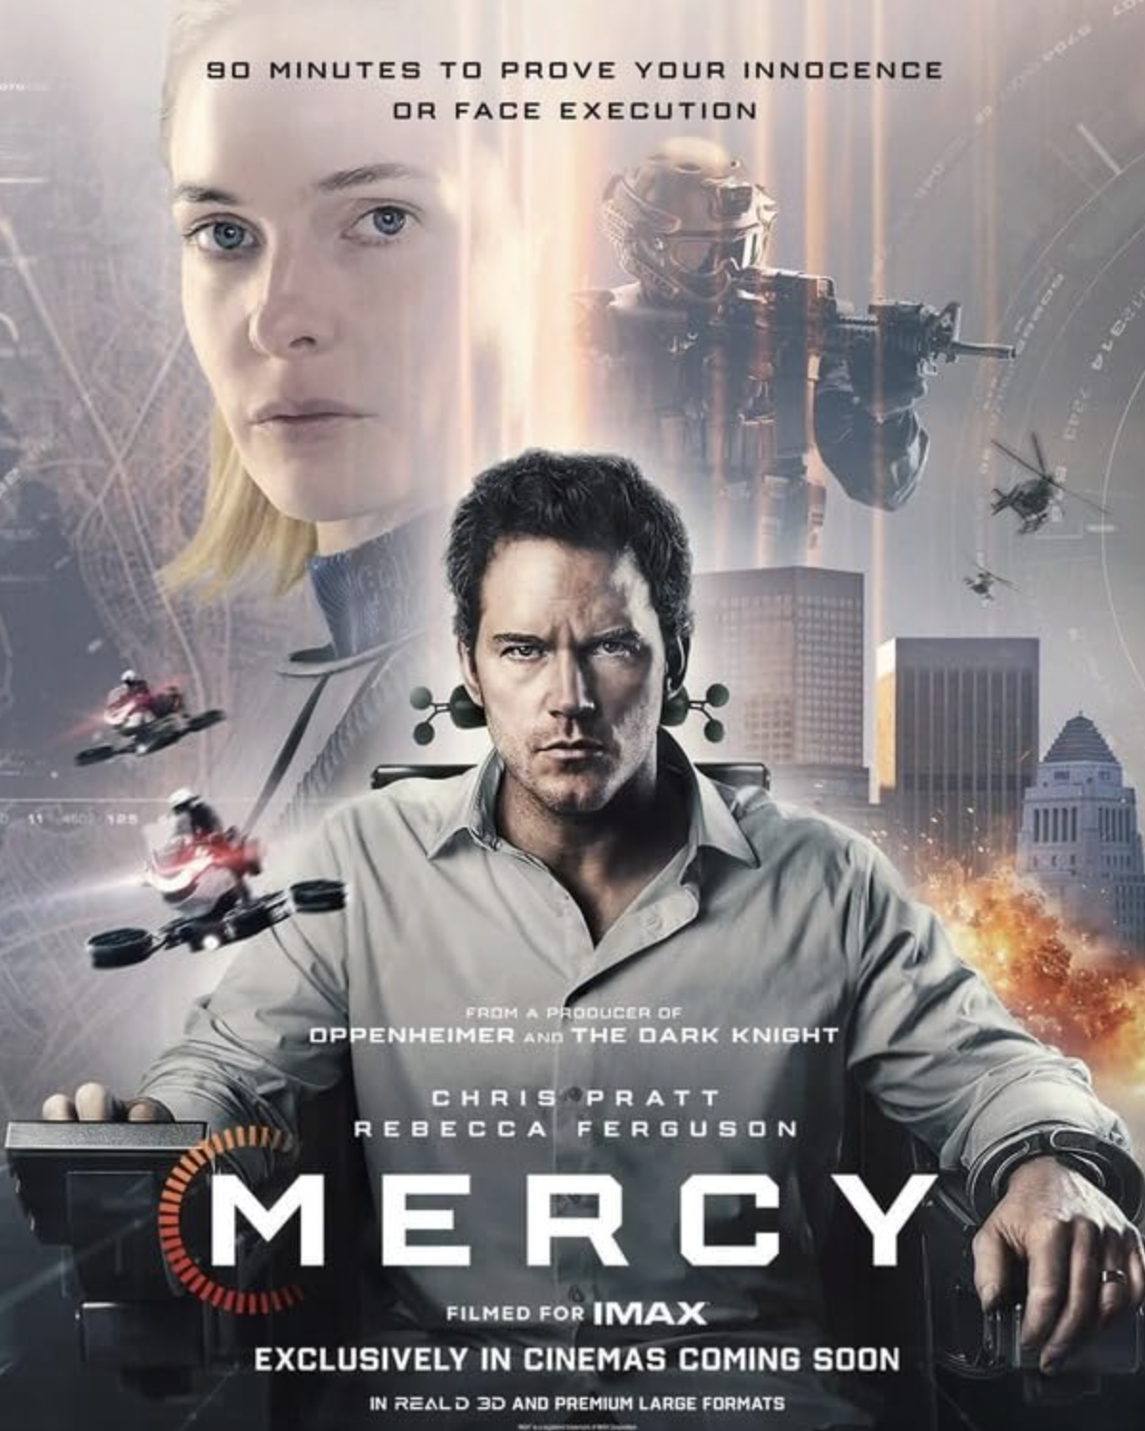
Mercy
Amazon MGM Studios
12A

Slide 2

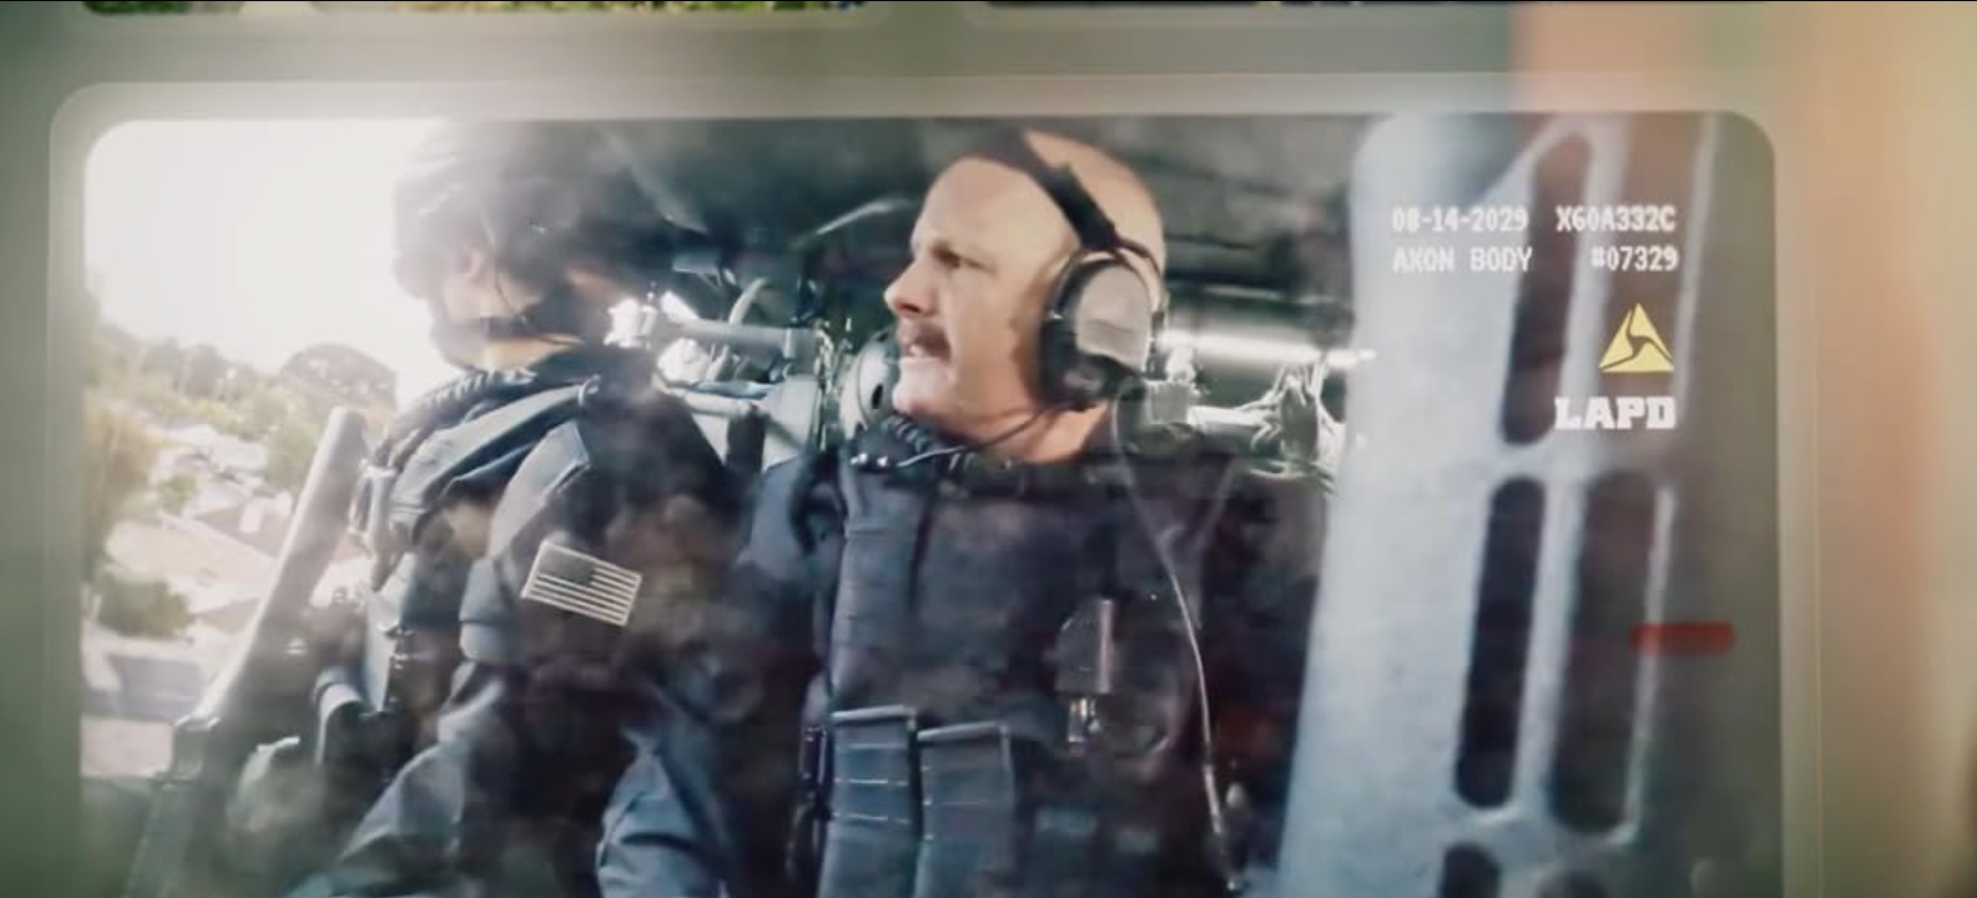
A dangerous world with criminals walking free and crime rates rising

Slide 3
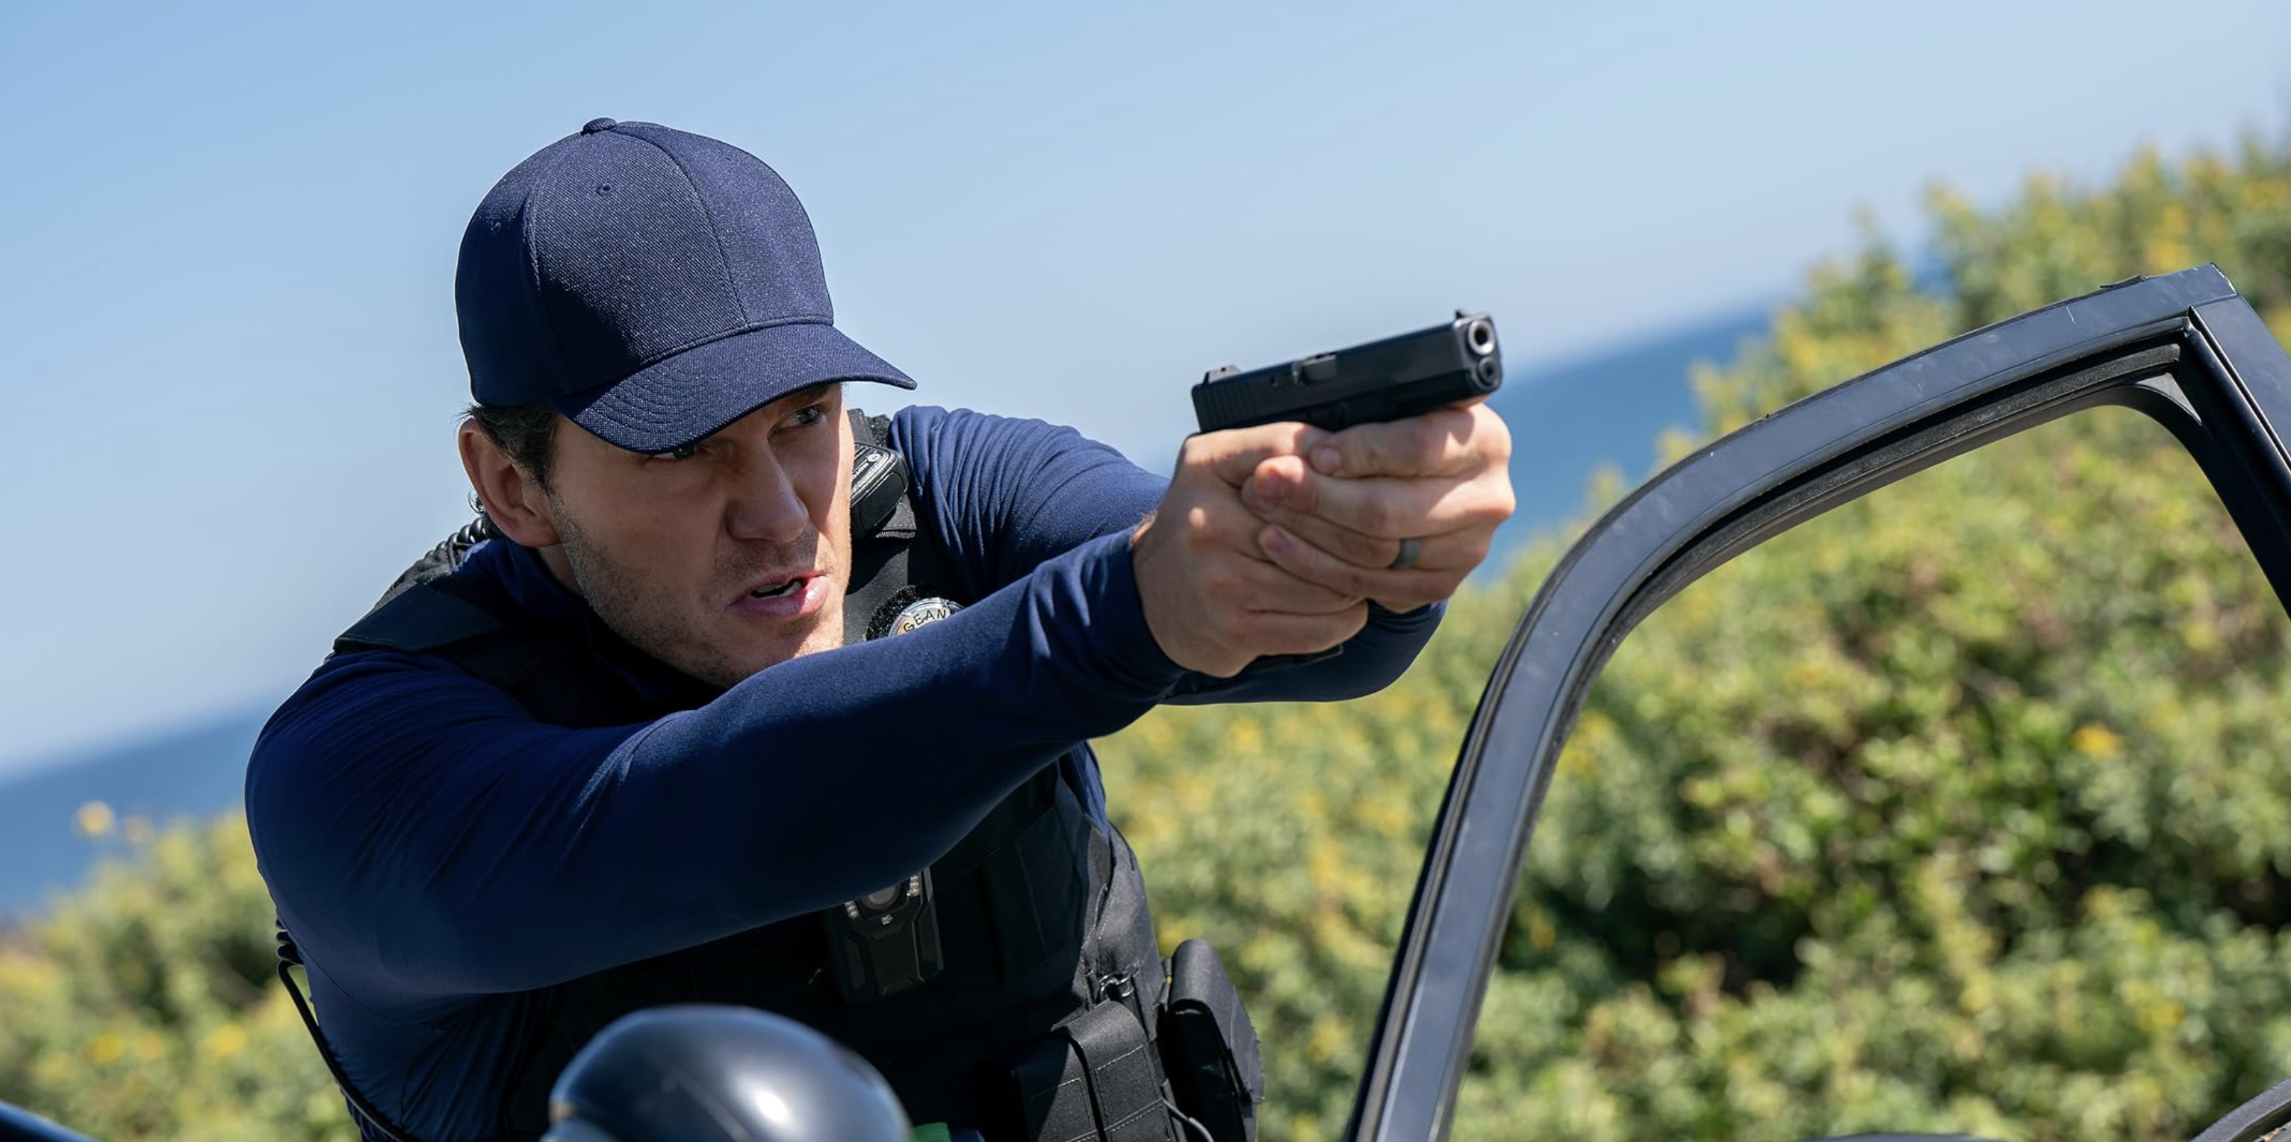
Detective Chris Raven

Slide 4
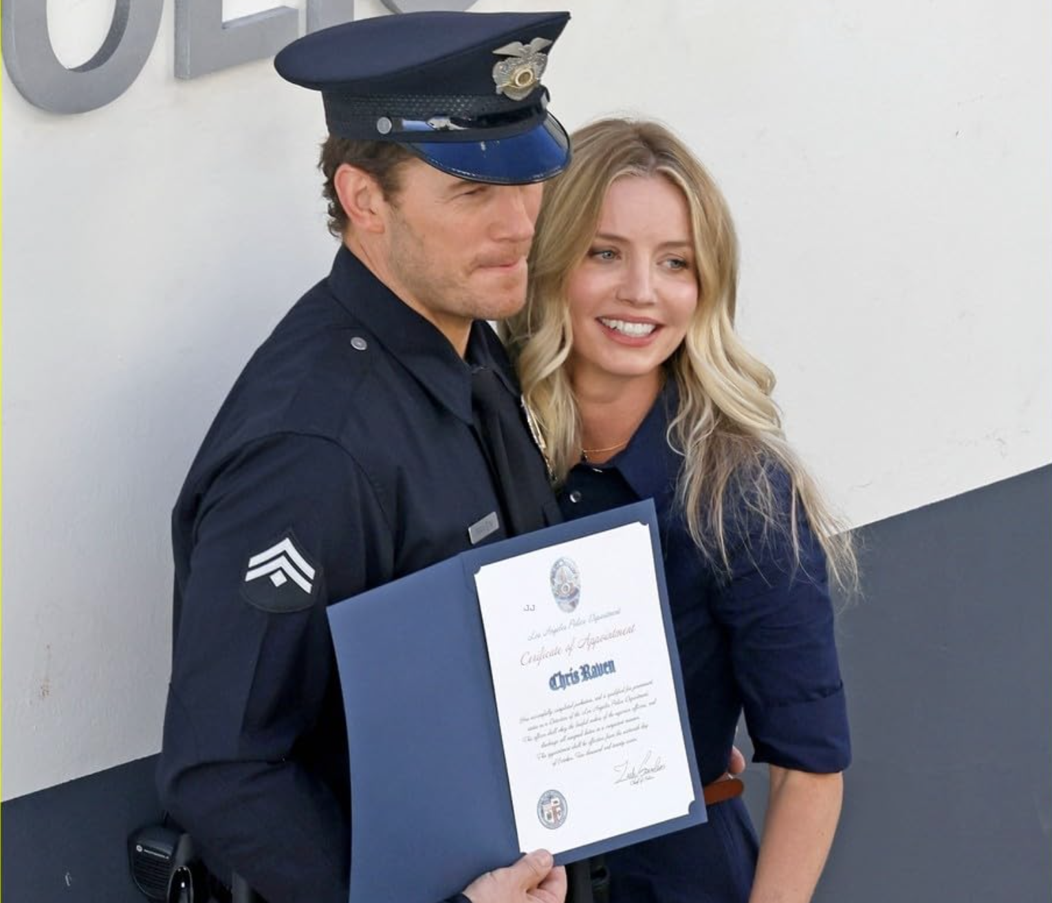

He establishes the Mercy Court which uses AI to deliver swift justice

Slide 5
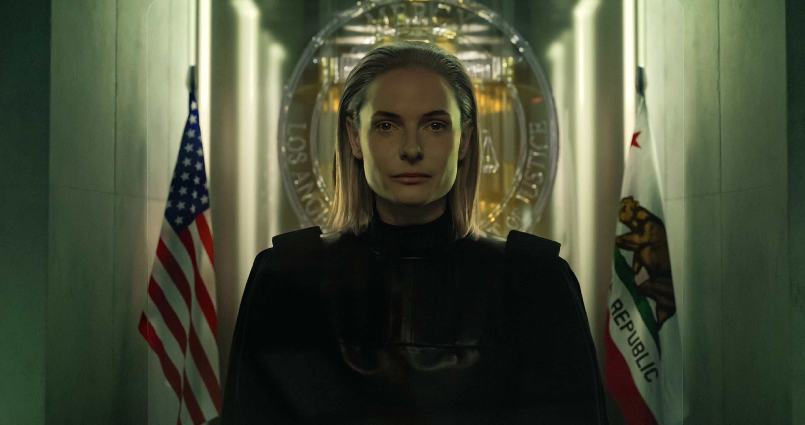
AI Judge Maddox can access
all cameras, phones, and databases

Slide 6
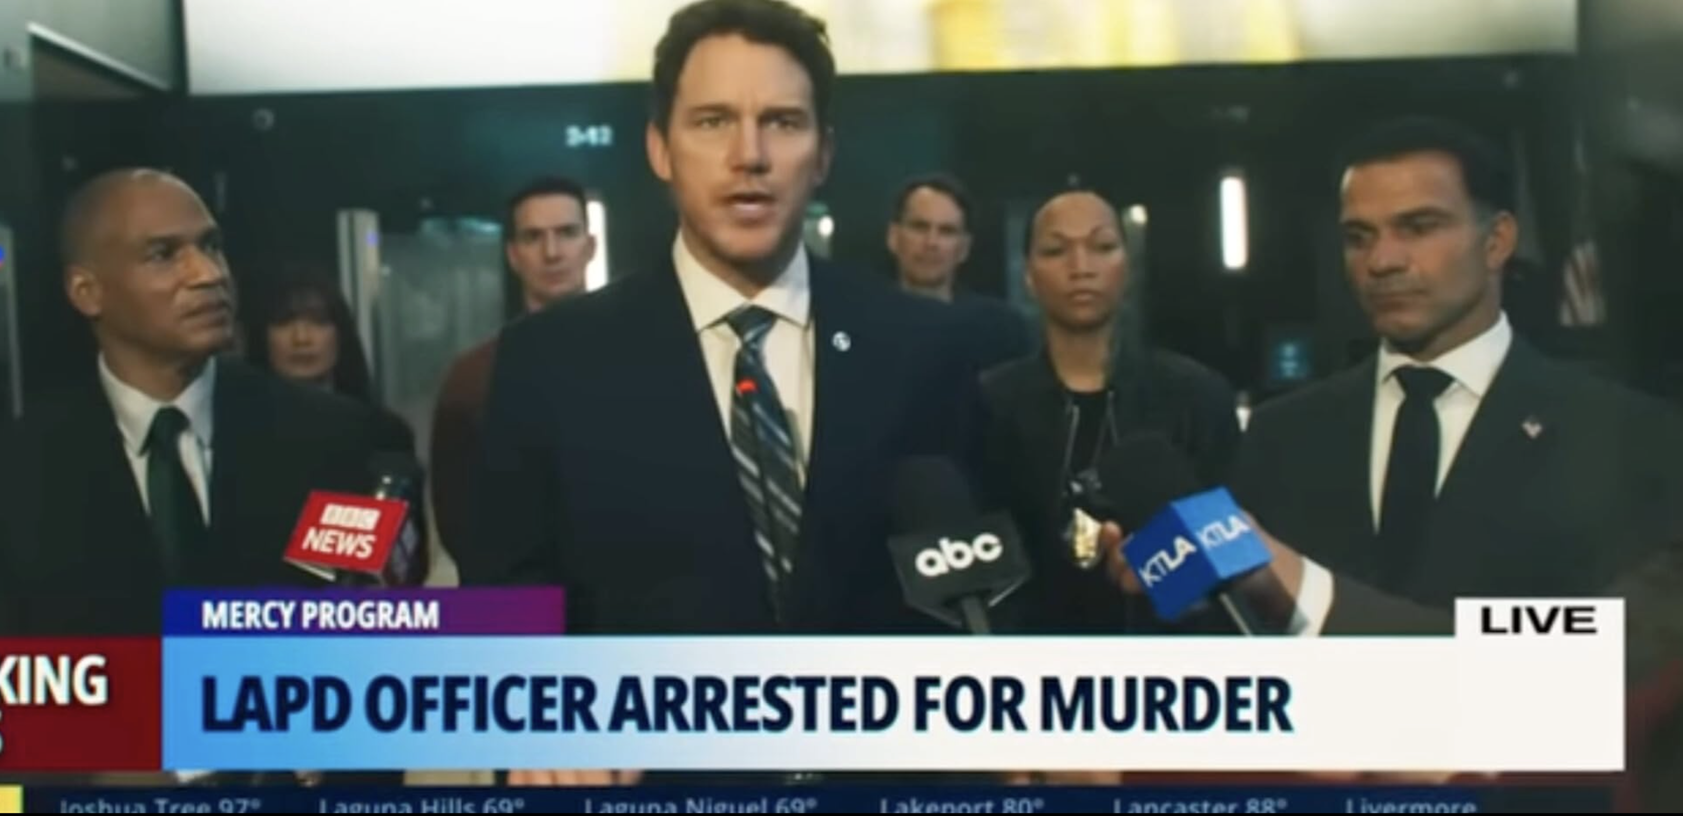
Detective Raven is then arrested

Slide 7
He has 90 minutes to prove his innocence

Slide 8
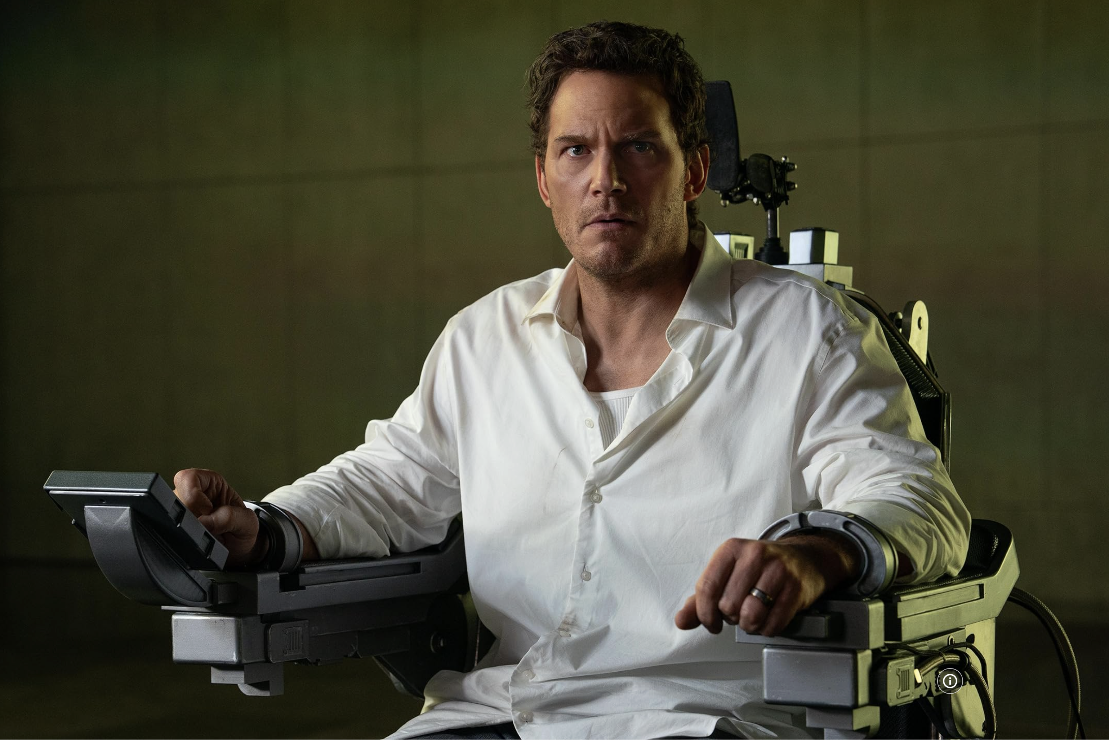
Detective Raven faces the Mercy Court
and the electric chair

Slide 9
97.5% probability of guilt is well above
the threshold to proceed

Slide 10
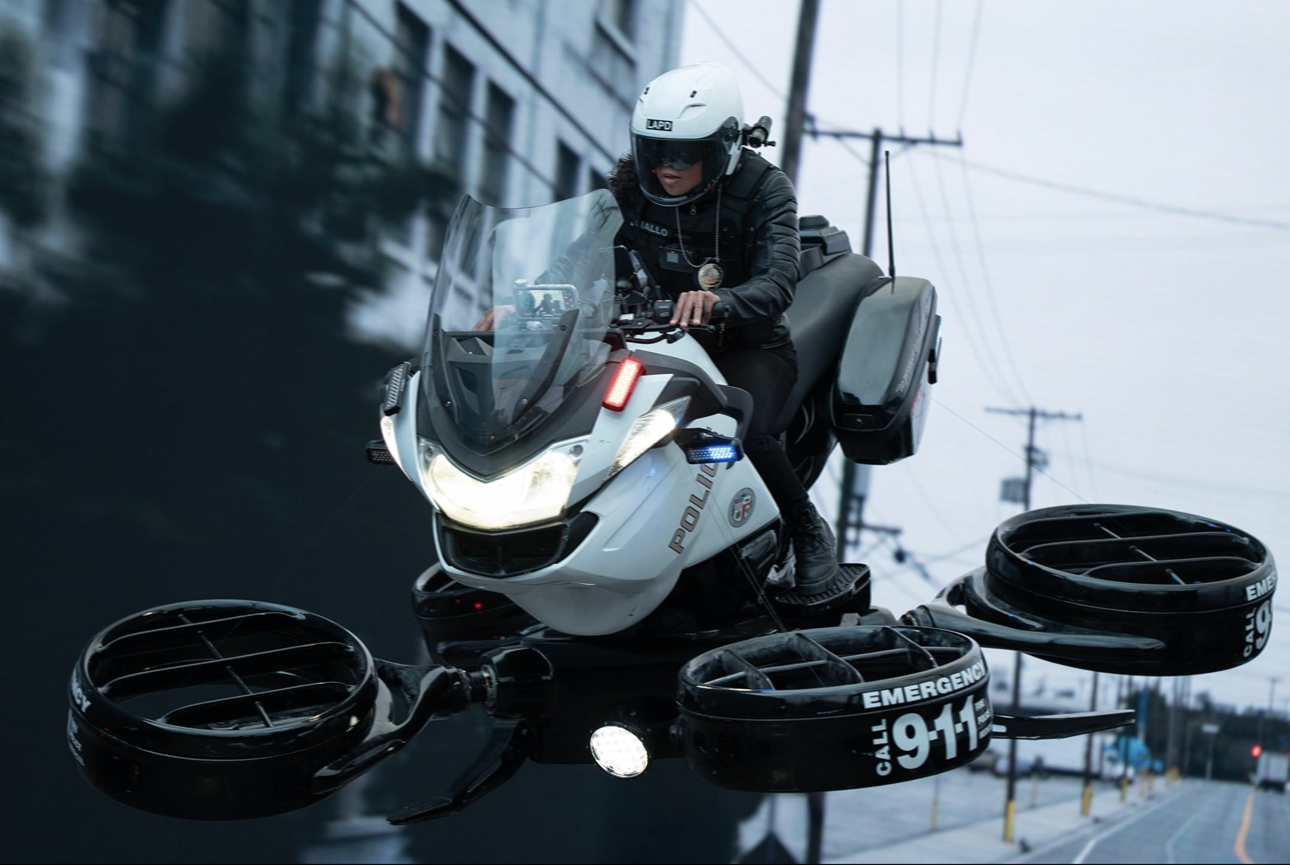
Raven’s police partner tries to source information

Slide 11
The AI judge says that
the court deals only in facts

Slide 12
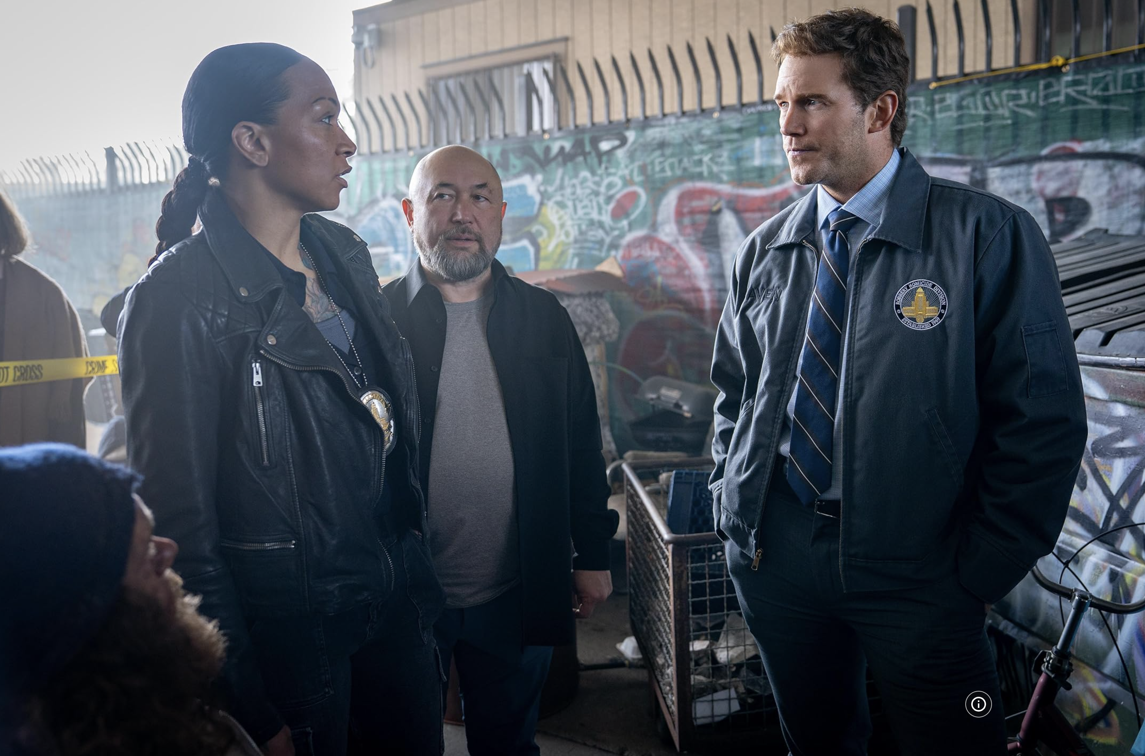
Raven says that facts are only the
starting point of an investigation

Slide 13
Is AI attractive because
it could provide an impartial objective
all-knowing judge outside of human limitations?

Slide 14
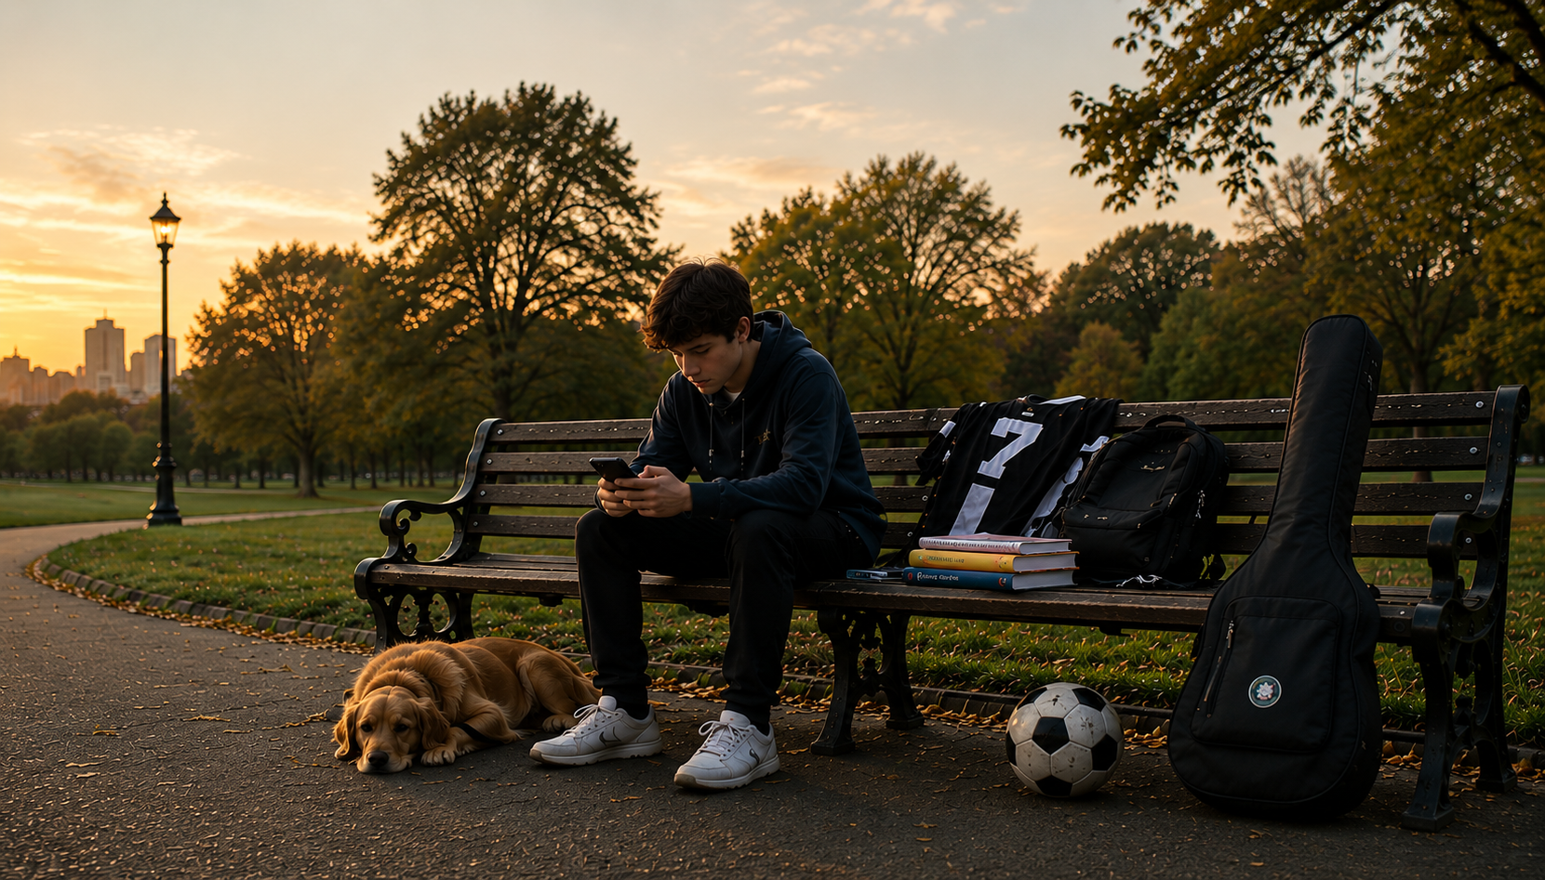
Psalm 139:1 “Lord, you have seen what is in my heart. You know all about me.”

Slide 15
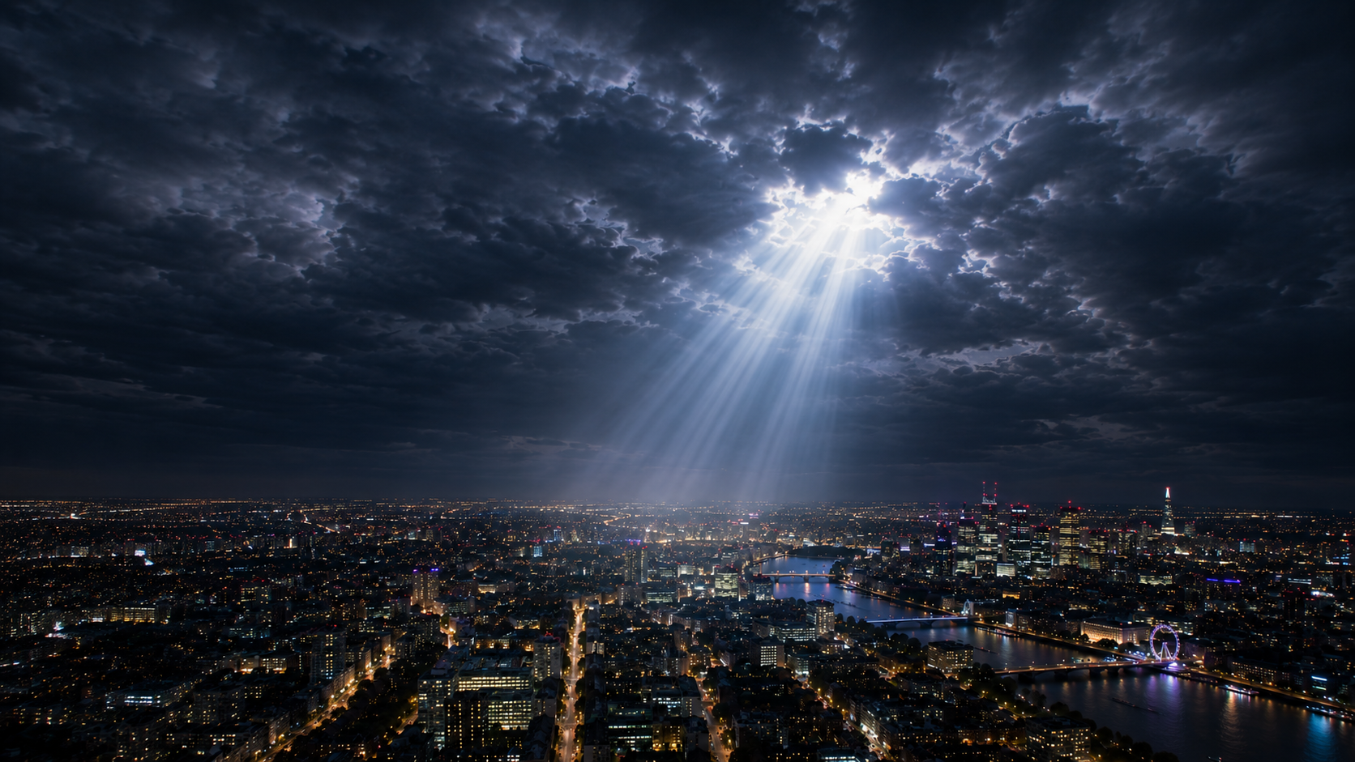
Hebrews 4:13 “Nothing God created is hidden from him. His eyes see everything.”

Slide 16
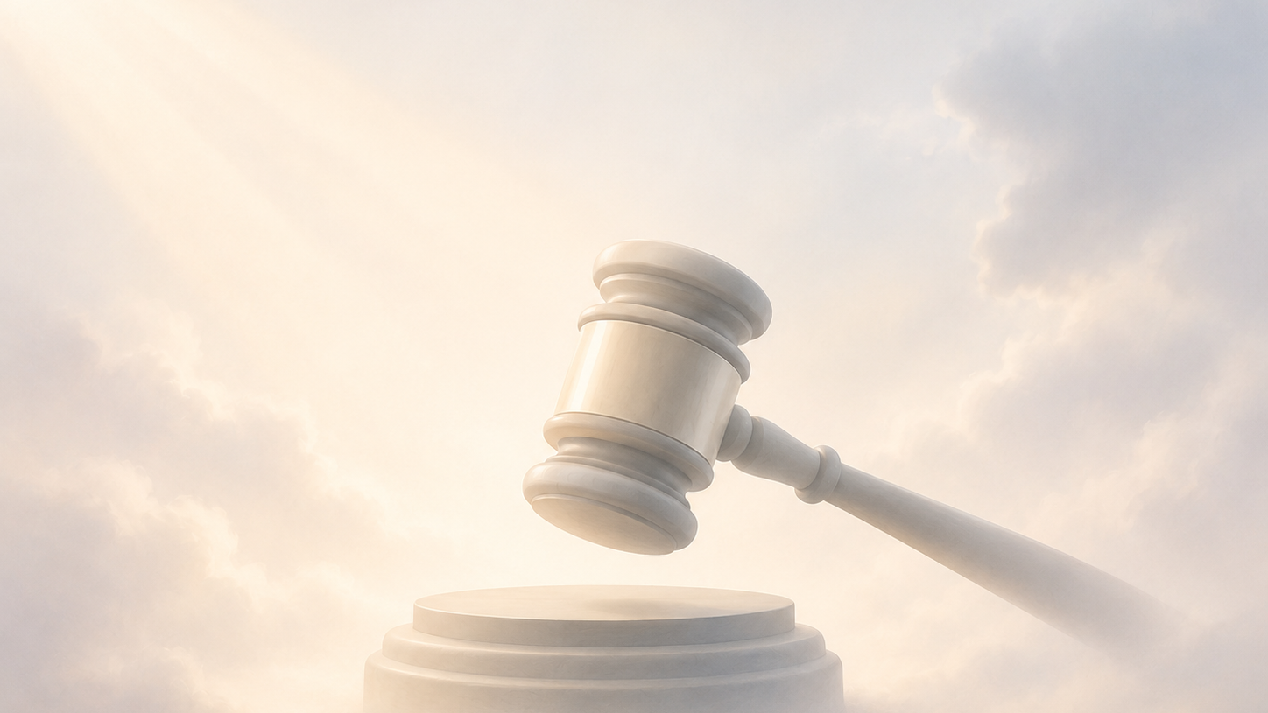
Romans 2:2 “We know that when God judges those who do evil things, he judges fairly.”

